Slide 1
Employee Data Analysis using Excel
STUDENT NAME: Pooja A
REGISTER NO: asunm1353312209438
DEPARTMENT: Bcom (Accounting and Finance)
COLLEGE: Anna Adarsh college for women

Slide 2
PROJECT TITLE
HR Employee Attrition Analysis using Excel

Slide 3


AGENDA
Problem Statement
Project Overview
End Users
Our Solution and Proposition
Dataset Description
Modelling Approach
Results and Discussion
Conclusion
3/21/2024 Annual Review

Slide 4

PROBLEM STATEMENT
The HR employee Attrition data lack clarity, making it challenging to accurately assess individual contributions and areas for improvement.

Slide 5

PROJECT OVERVIEW
.
Analyzing the HR Attrition data of the employees by considering the various data like gender, departments, age etc. To determine the Attrition rate are high, medium or low. The goal is to provide insights and to develop a more accurate and actionable evaluation.

Slide 6

WHO ARE THE END USERS?
Managers and Supervisors
HR Department
Employees
Executives and Leaders
R&D team.

Slide 7

OUR SOLUTION AND ITS VALUE PROPOSITION
Conditional formatting – to highlight patterns and trends based on certain conditions.
Filter – Analyze data by sorting and hiding it according to specific criteria.
Pivot table – To convert the data into brief summary.
Slicers – To filter data in PivotTables
Graph – For data visualization.

Slide 8
Dataset Description
Dataset Name: HR Employee Attrition.
Purpose: To analyze and predict employee attrition (i.e., when employees leave the company).
Overview: This dataset contains employee attrition including age, gender, attrition, department, job role, education, marital status etc.
Data Structure: The dataset consist of a single table named HR Attrition containing various attributes. These variables are used to analyze trends and correlations in employee performance, satisfaction, and work-life balance.
Data Types: Categorical and Numerical data.

Slide 9

THE "WOW" IN OUR SOLUTION
Data cleaning : Remove duplicates and handled missing values.
Conditional Formatting: Highlighted patterns based on certain conditions.
3/21/2024 Annual Review
9

Slide 10
MODELLING
Cleaned the employee data.
Used pivot tables to analyze attrition trends.
Applied conditional formatting to highlight key metrics.
Created charts and slicers to visualize and filter attrition data.
10

Slide 11
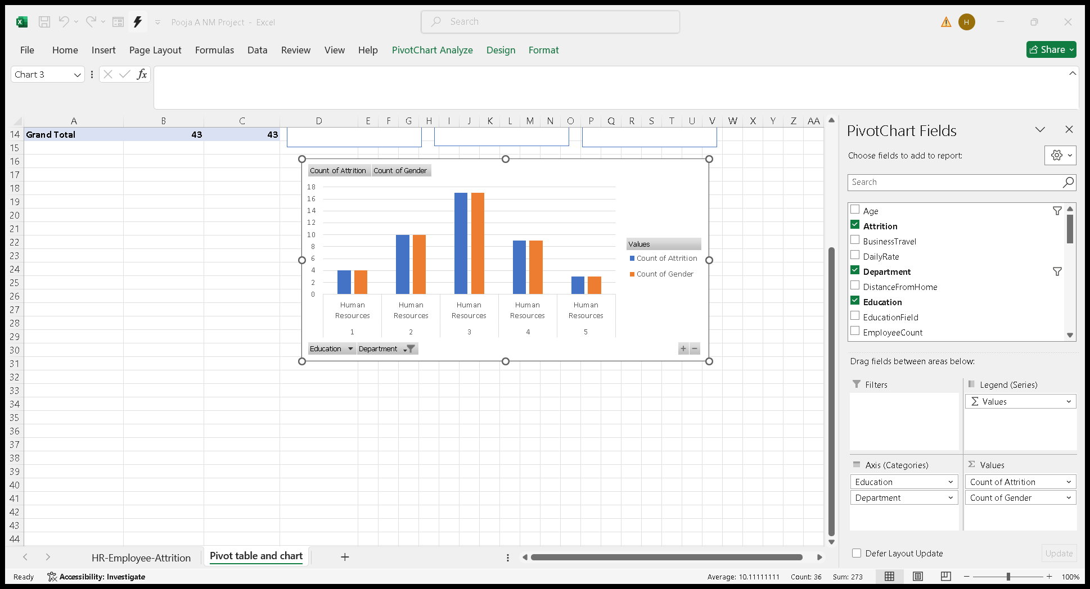
RESULTS
11

Slide 12
conclusion
In conclusion, the analysis highlighted significant patterns in employee attrition related to department, job role, and employee satisfaction.
By focusing on these key areas and implementing targeted retention strategies, the company can effectively reduce turnover and improve overall employee retention.

